Slide 1

Car Crashes in Melbourne
Kevin Tanila
BCom. Finance and Accounting

Slide 2
Background
Every year, Melbourne, Victoria has roughly 13000 accidents in all the suburbs. The following is the number of crashes per year from 2006 to end of 2018.

Slide 3
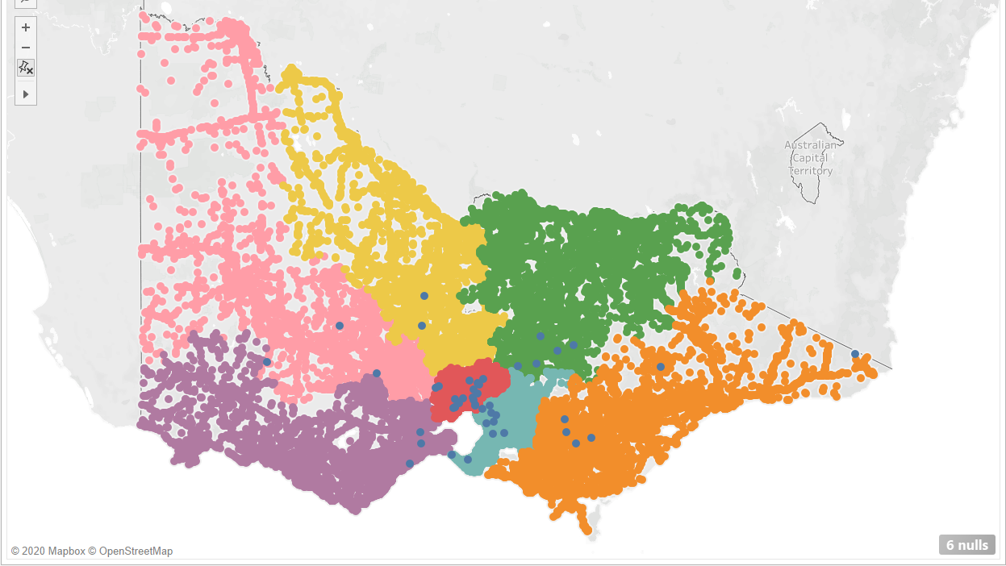

Slide 4
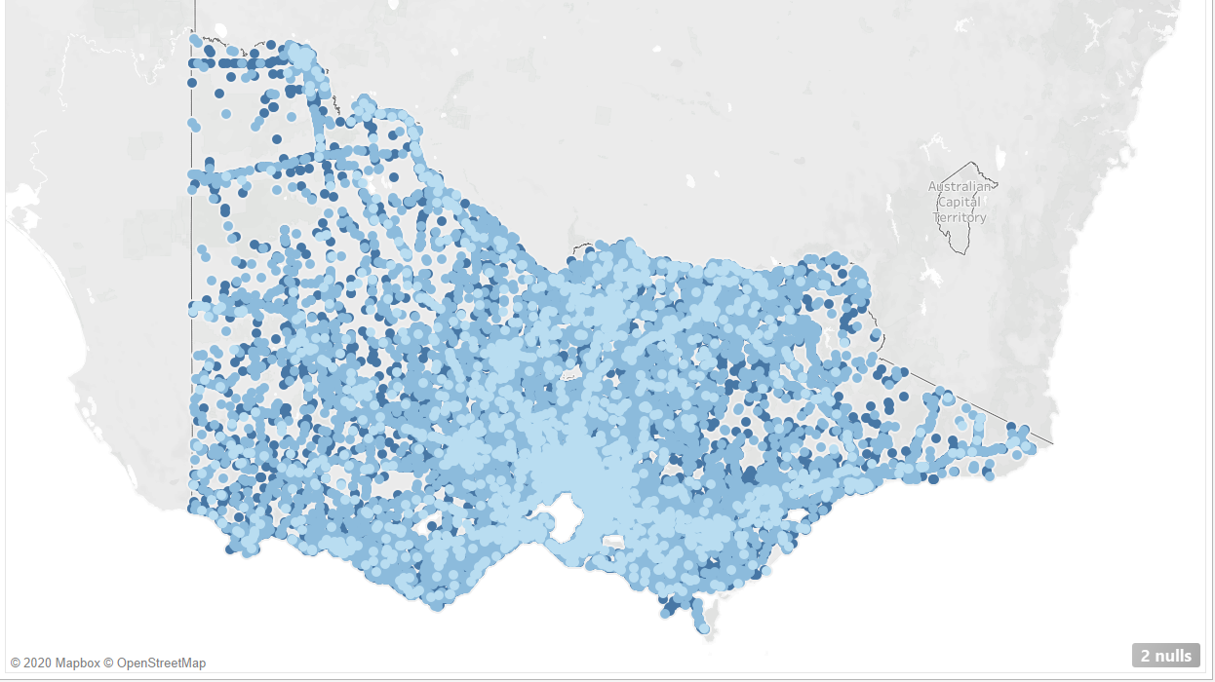

Slide 5
Business Question and Data Question
Business Question:
How to determine the severity of a crash?
Data Question:
How to classify the severity with accuracy higher than 66%?
How to determine the severity of a crash based on the environment?

Slide 6
Data Insights

Slide 7
Datasets
1. Accident: The de-centralized datasets.
2. Atmospheric Condition during the accident
3. Road Surface Condition during the accident
4. Vehicle type involved in the accident
5. Description of the person involved in the crash
6. Node ID where the crash happened
Note. The name of the person has been altered for privacy reasons.

Slide 8
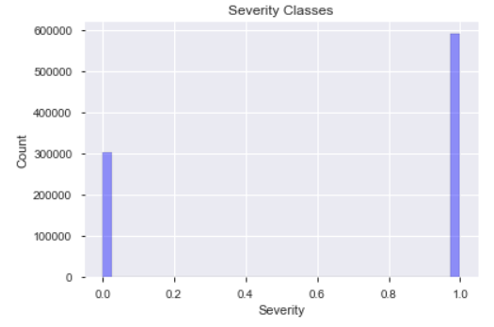
Severity Measurement
Severity was classified into 4 categories, ranging from 1 to 4. 1 is the lightest severity and 4 is the heaviest.
For this project, the severity will be classified into 2 categories instead where 1 & 2 belongs into light severity and 3 & 4 falls into the high severity.

Slide 9
Features
Atmospheric Cond Description
Road Surface Type Description
Light Condition Description
Surface Cond Description
Road Geometry Description
Vehicle Type Description
Vehicle age
Driver’s gender

Slide 10
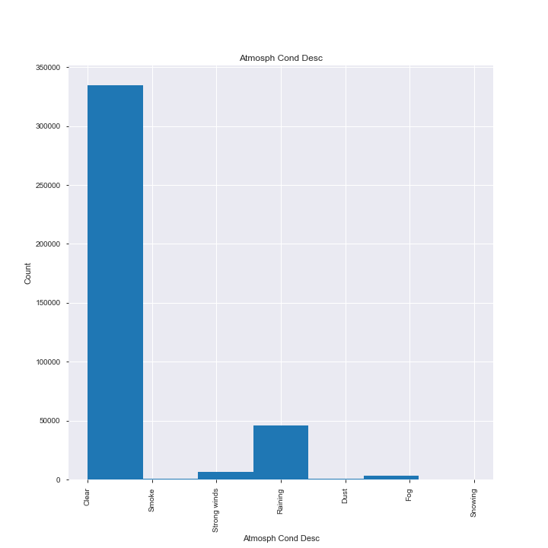
Atmospheric Conditions

Slide 11
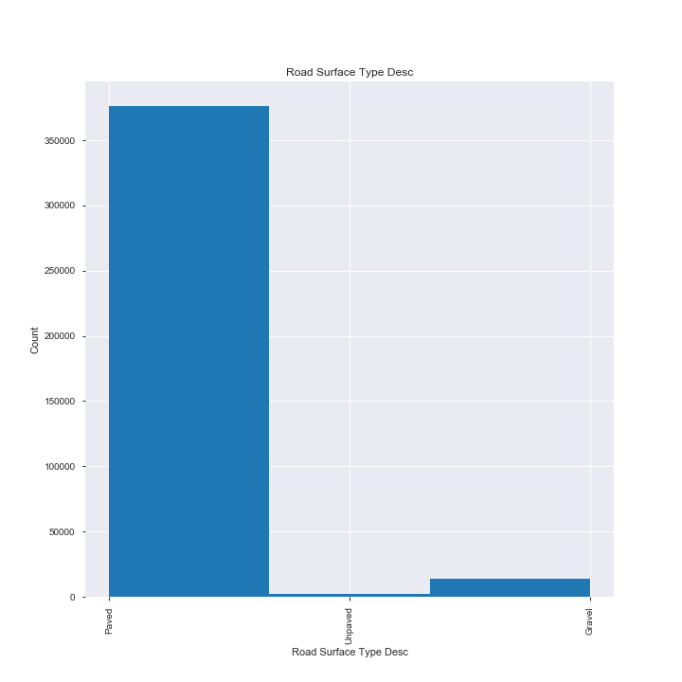
Road Surface

Slide 12
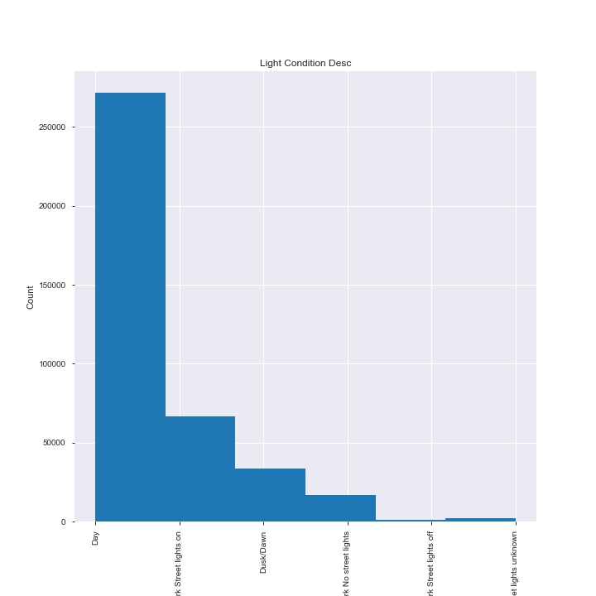
Light Condition

Slide 13
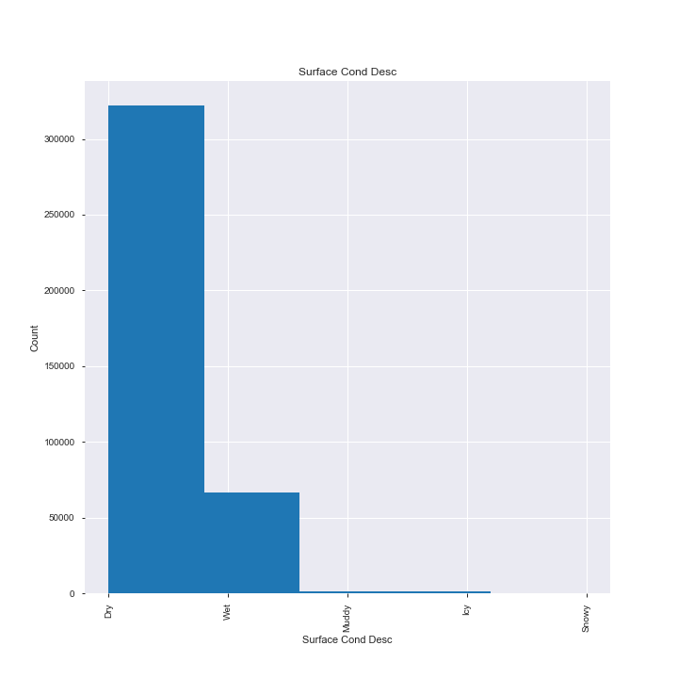
Surface Condition

Slide 14
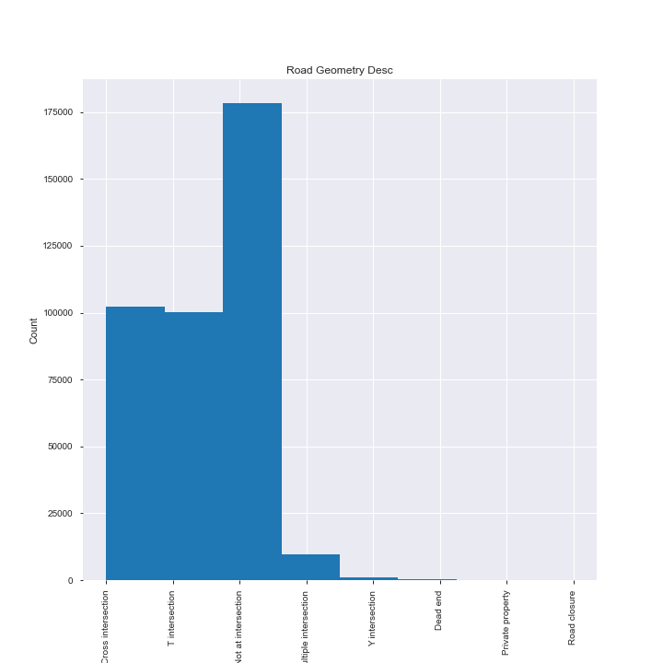
Road Geometry

Slide 15
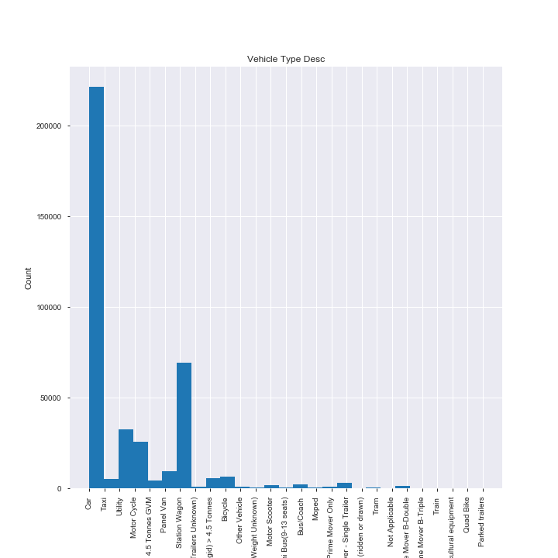
Vehicle Type

Slide 16
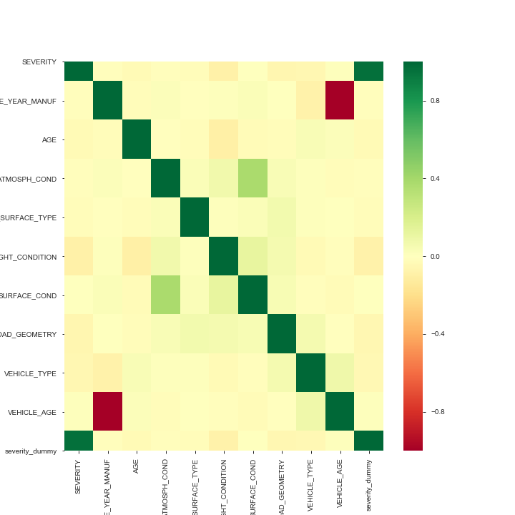
Heatmap for correlation

Slide 17
Models

Slide 18
Models Involved
Decision Tree
KNN
Logistic Regression
Support Vector Machine
K-Means
Naive Bayes, Gaussian
Random Forest
Gradient Boosting

Slide 19
Model Result – All Features
Model | Training |  |  |  |  | Testing
 | Accuracy | Precision | Recall | ROC AUC | F1 score | Accuracy | Precision | Recall | ROC AUC | F1 score
Decision Tree | 0.582 | 0.582 | 0.582 | 0.511 | 0.726 | 0.581 | 0.581 | 0.581 | 0.513 | 0.724
K-NN | 0.688 | 0.688 | 0.688 | 0.731 | 0.633 | 0.417 | 0.417 | 0.417 | 0.445 | 0.342
Logistic Regression | 0.587 | 0.587 | 0.587 | 0.524 | 0.719 | 0.586 | 0.586 | 0.586 | 0.526 | 0.718
Naive Bayes | 0.577 | 0.577 | 0.577 | 0.527 | 0.697 | 0.574 | 0.574 | 0.574 | 0.526 | 0.694
Random Forest | 0.854 | 0.854 | 0.854 | 0.847 | 0.877 | 0.440 | 0.440 | 0.440 | 0.422 | 0.527
Gradient Boost | 0.591 | 0.591 | 0.591 | 0.521 | 0.729 | 0.586 | 0.586 | 0.586 | 0.520 | 0.726

Slide 20
Conclusions
This is particularly useful when combined with weather predictions and map pathfinders, a great addition to map navigators to warn the risk to the driver or people who are using the app to navigate.
Decision Tree, Logistic Regression, & Naïve Bayes gives a robust 70% accurate result.
However, more features is required to predict severity of the crash. I.E. Traffic condition surrounding the crash

Slide 21
Question

